Slide 1
Cash Management
Bank Account Maintenance and Bank Statement Reconciliation
30th April, 2020

Slide 2
Agenda
1. Program Background | 0 mins
2. Change Management | 0 mins
3. Platform & Process Scope | 0 mins
4. Maintain Bank Account | 30 mins
5. Reconcile Bank Statement | 30 mins
6. Bank Account transfer​s & External transactions | 30 mins
7. Cash Forecasting | 5 mins
8. User Stories | 5 mins
9. Next Steps | 5 mins
10. Appendix | N/A

Slide 3
1. Program Background

Slide 4
Timeline

Slide 5
Process and Platform Scope
ERP
EPM
Record to Report
Procure to Pay
Order to Cash
Close to Consolidate
Plan to Forecast
Manage Metadata
Perform GL Transaction Processing
Perform Fixed Asset Accounting
Manage Suppliers
Procure & Receive Material and Services
Manage Customers
Manage Accounts Receivables
Perform Translation
Perform
Intercompany Elimination
Perform Forecast/
Budget
Integrated Workforce Planning
Request master data updates
Manage hierarchies
Manage Cash
Process Inter
-company
Pay for Materials & Services
Setup and Maintain Employee Record & Approvals
Manage Revenue
Manage Collections
Apply Topside Journals
Load Supplemental Data
Perform Scenario Analysis
Perform Analytical Reporting
Approve master data updates
Manage application specific properties
General Ledger
Supplier Management
Accounts Receivables
Intercompany Elims
Financials
Data Relationship
Management
Cash Management
Purchasing
Collections
Journal Entry
Workforce
Fixed asset
Self Service Procurement
Customer Management
Ownership Management
Capex
Data Governance
Intercompany
Supplier Portal
Close Management
Strategic Modeling
Payables
Security & Controls, Technology, Tax, Change Management, Localizations
= Oracle Cloud Service

Slide 6
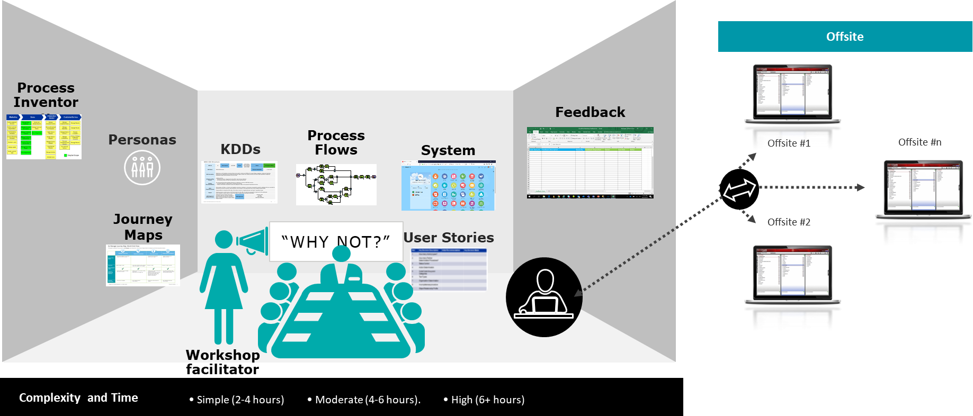
Solution Confirmation Workshop
We use a “show and tell” approach to iteratively validate your process and application design side by side
During workshop
Define key design decisions (KDDs)
Review process flow
Review user stories
Review roles and process controls
Discuss configuration variances
Demo system
Capture feedback
After workshop
Resolved workshop feedback
Refined KDDs
Updated process flow
Updated user stories
Updated roles and process controls
Updated configuration workbook
Documented change impacts

Slide 7
Solution Confirmation Workshop Types
End-to-End business transaction flow focusing on sunny day / happy path (without development objects)
e.g., Procure and capitalize asset
Create and Approve PR
Create Purchase Order
Receive Goods 3 Way-Match
Capitalize asset
E2E
1
Deep-dive
Master Data
Conversion
Localization
Sessions targeted for Deep-dive on
KDDs / Foundational design topics e.g., COA
Functionality deep-dive
Exception/Variation scenarios or additional flavors of E2E e.g., Cross track stakeholder walkthrough
Sessions focused on Master Data entities
Data model, Attribution, system of truth
Master data governance e.g. , procurement category structure
Sessions focused on conversion planning and execution
Entities, attributes, Selection criteria
Business validation, de-duplication and clean-up
Recon reports
Sessions focused on addressing localization
Legal / statutory local requirements
Country / region specific Tax , reporting, documentation, templates and formats
Focus Groups
2

Slide 8
Solution Confirmation Workshop – Roles & Responsibilities
Process Owner
Process SME
Product Manager
Business / IT SMEs
Process Lead
Make business process and design decisions
Provide / validate user stories (requirements)
Asking ‘why not’ for adopting standard process and tools
Provide input on business needs and decision making
Provide / validate user stories (requirements)
Provide inputs on IT landscape / Application
Support process owners with decision making (through IT lens)
Support with data requests
Provide subject matter expertise on specific functional areas and support data requests
Provide / validate user stories (requirements)
Facilitate session
Present standard industry processes and Oracle capabilities
Scribe
Change
Capture meeting minutes, user stories, potential gaps and process deviations
Participate in key relevant workshops
Capture change impacts, complexity of the change, impacted roles and type of support required
client | Deloitte

Slide 9
2. Change Management

Slide 10





Project Notorious: Introduction to Change Impact Assessment
The Change Impact Assessment is the process to identify changes introduced by Project Notorious, the scale of changes, impacted audiences and the recommended activities to support adoption of these changes
What it is
An approach to address organizational change by:
Identifying and categorizing changes
Assessing and ranking the degree of impact that each change will have on impacted internal and external audiences
Defining plans to mitigate the impact of each change
Inputs
Business processes
Design workshop content
Final design decisions
Business role definitions
Active Participants
Process Owner
Process SME
Product Manager
Business SMEs
IT SMEs
Change Management Team
The Process
Capture Change Impacts during design workshops using excel template
Validate impacts with key stakeholders during Change Impact Readout
Consolidate captured impacts in a Change Impact Assessment Report
Outcomes
Communication Plan
Change Management Strategy
Training Strategy
Training Curriculum
Change Network
Trainer Onboarding Approach

Slide 11
Project Notorious: Process to Capture Change Impacts
The Change Impact Assessment Template provides project and business team members with a step by step guide to capture changes across four categories
1
Access the Change Impact Assessment Template by clicking the icon at the bottom of the page
Download Template
2
Enter the reference number, the name of the workstream, the workshop in which the impact was captured, the date it was captured, the process name and the change name
Workshop and Process Details
3
Enter a description of the current state process and the predicted future state of the process after the Go-Live
Change Impact Assessment Template Categories
Current and Future State
4
Enter the anticipated impact this change will have on the end user, the overall level of impact (High, Medium, Low) and the audience that will be impacted by this change
Impact
Enter "Y" for "Yes" or "N" for "No", indicating whether you think the change impact will require a Communication or Training Change Management activity to mitigate the impact of the change
5
Activity Requirements
6
Upload the Change Impact Assessment Template here: https://drive.google.com/drive/folders/1X8n2NgL0JLHXej8hUuo4ail0a3NCkQC4
Upload Template

Slide 12
3. Process and Platform Scope

Slide 13
Industry Print Business Process Taxonomy
Process Group (L0)
Process (L1)
Sub-process (L2)
Task (L3)
RTR
RTR020
RTR020-010
RTR020-010-040
Sample
Hierarchy
Record to Report
Perform Fixed asset Accounting
Perform Asset Additions
Post Mass Additions
Process Group name
Description including:
Value Chain
Leading industry practices
Process vision
Process name
Description including:
Business function within the value chain
Policies
Key Performance Indicators (KPIs)
Sub-process name
Description including:
Volume and frequency
Change impact differences, implications, benefits, risks and action plan
Configuration notes
Task name
Task description
Control point
Controls
Security restrictions
Task localisation
Content

Slide 14
Project Notorious – ERP Process Scope
Reporting
Level 0
Security and Controls (S&C)
Organizational Change Management (OCM)
Procure to Pay (PTP)
Order to Cash (OTC)
Record to Report (RTR)
Level 1
Manage Suppliers
Procure & Receive Materials and Services
Setup and Maintain Employee Record and Approvals
Pay for Materials and Services
Manage Customers
Manage Receivables
Perform GL Transaction Processing
Perform Fixed asset Accounting
Manage Cash
Process Intercompany
Create supplier Master Data
Create and Maintain Purchase Requisitions
Setup Employee Records
Process Supplier PO Invoices
Create and Maintain Customers
Process Receipts
Perform Transaction Processing - Process Interfaced Journal Entries
Perform Asset Additions
Reconcile Bank Statements
Process IC Transactions
Maintain supplier Master Data
Approve Purchase Requisitions
Setup and Maintain Approvals
Process Supplier non-PO Invoices
Manage Customer Credits
Manage Collections
Process Manual Journal Entries - Monetary and Statistical
Maintain asset
Maintain Bank Account
Net / Settle IC Accounts
Merge suppliers
Purchase Materials and Services
Manage invoice holds
Invoice Customers
Perform Transaction Processing - Process Recurring Journal Entries
Retire and Dispose asset
Cash Forecasting
Manage supplier qualification and onboarding
Perform Transaction Processing - Process Reversing Journal Entries
Depreciate and Amortize asset
Manage Purchase Order Change Requests
Manage AP Inter-company Invoices
Manage AR Inter-company Invoices
Level 2
Manage the General Ledger - Maintain Chart of Accounts
Maintain Statutory and Tax Books
Manage supplier collaboration
Receive Materials and Services
Process Supplier Payment
Perform AR Period-End Closing
Manage the General Ledger - Maintain Currency and Associated Rates
Perform asset Period Close
Return Materials to Supplier
Manage Expense Reimbursements
Manage Disputes
Manage the General Ledger - Approve and Post Journal Entries
Manage Procurement Accruals
Recognize Revenue
Perform Closing - Perform Revaluations
Perform Closing - Perform Allocations
Perform GL Period-End Closing
Manage Accruals
L2 for this session

Slide 15
Approach, Objective & Expectation for the Session
Approach
Process, Oracle concepts and definition walk through: Bank account setup and maintenance, bank statement processing, bank account transfers and cash forecasting
Objectives
Review proposed process flows (where applicable) and Oracle capabilities
Review key design decisions, consider the available options and finalize the design
List down the action items with associated ownership
Document an action plan to close any open items not addressed during the session

Slide 16
Project Notorious - RTR High-level system landscape
Boundary Applications
Oracle Cloud
Boundary Applications
With Manual Load
Concur
Expense accounting
Workday
Head Count
Accounting for Leases
Thomson Reuters – FX Service
FX Rates
Oracle
General Ledger
Visual Lease
(Lease Accounting)
Accounting for Expense Accruals
FX Rates
Payroll related accounting
US ADP Payroll
Thomson Reuters – One Source
Balances
Non US Payroll
Blackline
COA, Currency, Periods
Revenue Recognition Entries
GL Balances
Revenue (Various)
Equity Journal Entries
Charles Schwab (Equity)
NetSuite
Inventory activity balances
Investment Journal Entries
Accounting for Payroll Payment
Clearwater
(Investments)
US ADP Payroll
FX Rates
Oracle Intercompany
BigQuery
Bank Statements
Cash Management
Fixed Assets
Concur
Banks??
Manual Load
Automated Interface
Notes:
Discussed with Kristen and closed:
Active Disclosure – Not required. Used for Disclosures. Data is loaded manually after period close to this system.
Blackline for Close – Not used. If used tasks are manually updated in Blackline
Open items:
How & from where are bank statements retrieved today?
Workday Integration for Head Count was a question for client IT – Not sure if this interface exists today?

Slide 17
RTR Platforms – By Function – Current vs To Be
Function | Current | To-be (Project Notorious)
Fixed Assets | Net Suite | Oracle Fixed Assets
Lease Management | Visual Lease | Visual Lease [Manual load to Oracle Cloud GL]
Journals & Balances | Net Suite | Oracle General Ledger
Inventory | NetSuite | NetSuite [Automated integration to Oracle Cloud GL]
Revenue Recognition | Various | Various [Manual load to Oracle Cloud GL]
US Payroll | US ADP Payroll | US ADP Payroll [Manual load to Oracle GL for Expense accrual, Payment entries-automated interface to Oracle GL]
Non-US Payrolls | Non-US Payrolls | Non-US Payrolls [Manual load to Oracle Cloud GL]
Intercompany Journals & Invoices | Custom Net Suite | Oracle Intercompany
Bank Account Maintenance | Kyriba | Oracle Cash Management
Bank Statement Reconciliation | Excel | Oracle Cash Management
Short Term Cash Forecasting | N/A | Oracle Cash Management (potential)

Slide 18
4. Maintain Bank Account

Slide 19
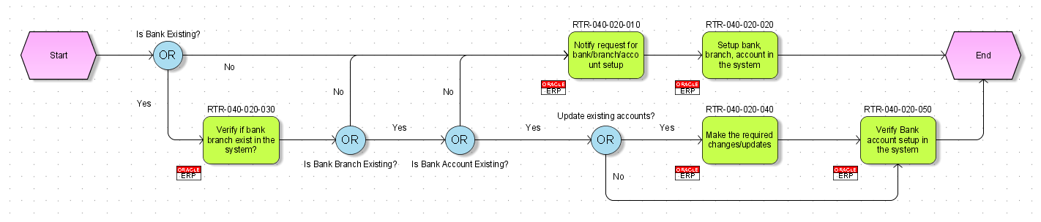
L2 – Maintain Bank Account - Process Flow

Slide 20




L2 – Maintain Bank Account
Process Map Alignment
L2 Overview
L0: Record to Report
L1: Manage Cash
Bank information
Bank Maintenance
Bank
Bank Branches
Bank Accounts
Business Unit Access
Validation Rules
Roles
Cash Manager Analyst
Cash Management Supervisor
Related KPIs
Cost of maintaining bank accounts
Percentage of transaction corrections
Bank reconciliation frequency
Key Inputs
Leading Practices
Process Inputs (Upstream/Downstream)
Maintain Bank Account:
Offline processes leading to bank / branch / account updates
Maintain quality of Master data E.g. Avoid creating duplicate banks or branches Rationalize Banks relationships/Accounts being used to bring in efficiency considering factors like global footprint of banking partner, are there branches near operations locations (especially for Payroll), is Bank a customer, Bank’s IT/Integration capabilities etc. Establish a way to uniquely tie a GL account / account combination to each bank account enabling faster reconciliation of GL with Bank Statement
Master Data
Banks Bank Branches Internal Bank Accounts
Key Design Decisions
NA

Slide 21
High level overview of Bank Structure
JPMC
Branch 1
client Acct 1
Customer 1 Acct
Branch 2
Supplier 3 Acct
Supplier 1 Acct
Supplier 2 Acct
Supplier 4 Acct
Wells Fargo
Branch 1
client Acct 2
HSBC
Branch 1
Supplier 5 Acct
Bank and Branch is a shared master data
Bank
Branch
Accounts
Maintained in Cash Management
(Internal Bank Account)
Maintained in Supplier Master
(Third Party Bank Accounts)
Maintained in Customer Master
(Third Party Bank Accounts)
Banks and Branches are common & maintained in Cash Management
Banks Accounts for Supplier are maintained in Supplier Master. Bank Accounts for Customers maintained in Customer master
client’s bank accounts (a.k.a. Internal bank accounts) are maintained in Cash Management
Maintained in Customer Master

Slide 22
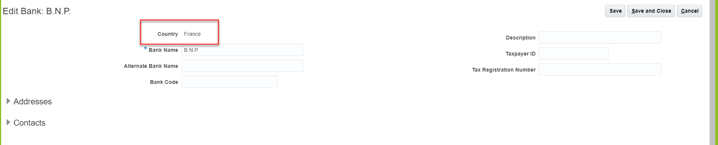
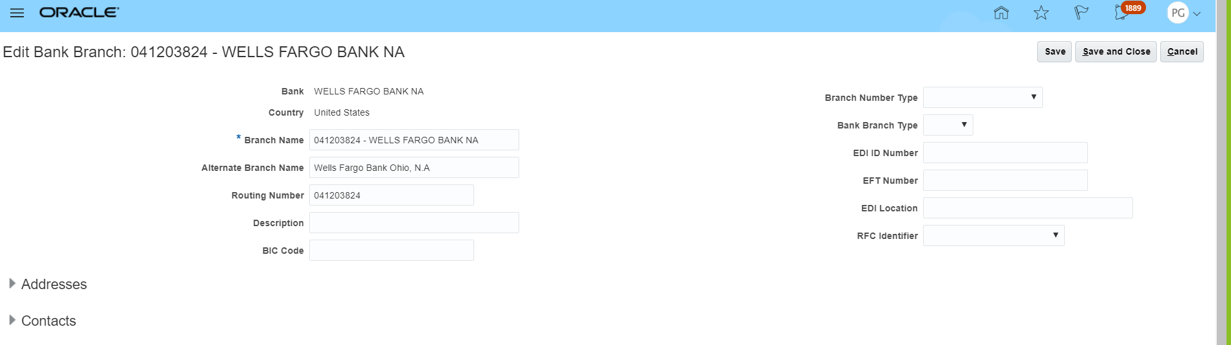
Banks and Branches
Banks are always defined in context of a country. Branches & Internal Bank accounts inherit country from Bank. In upcoming slides we will talk about country specific validations

Slide 23
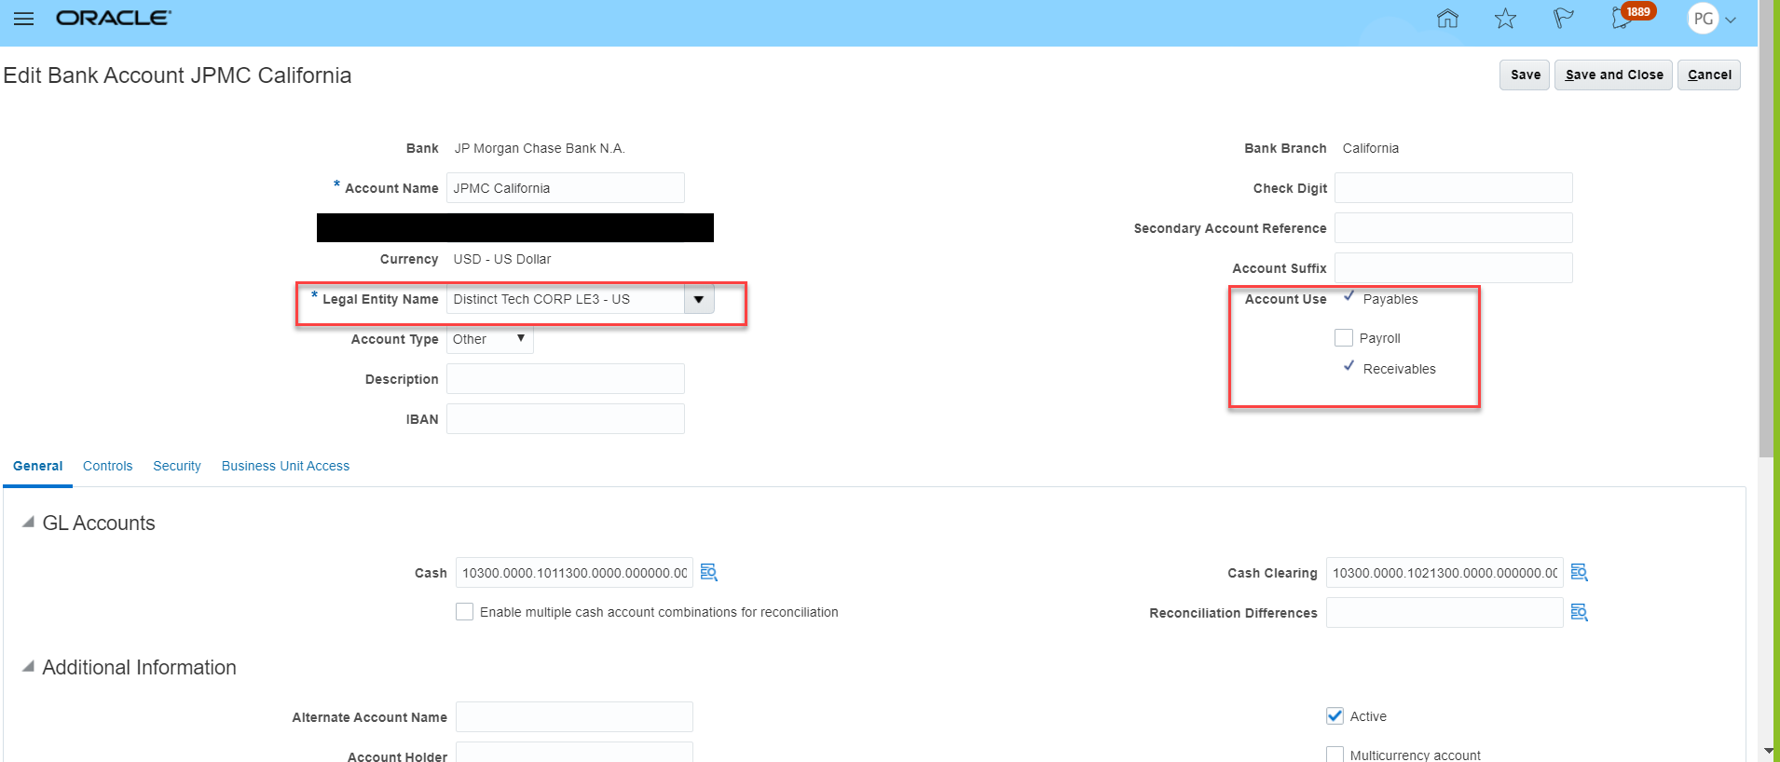
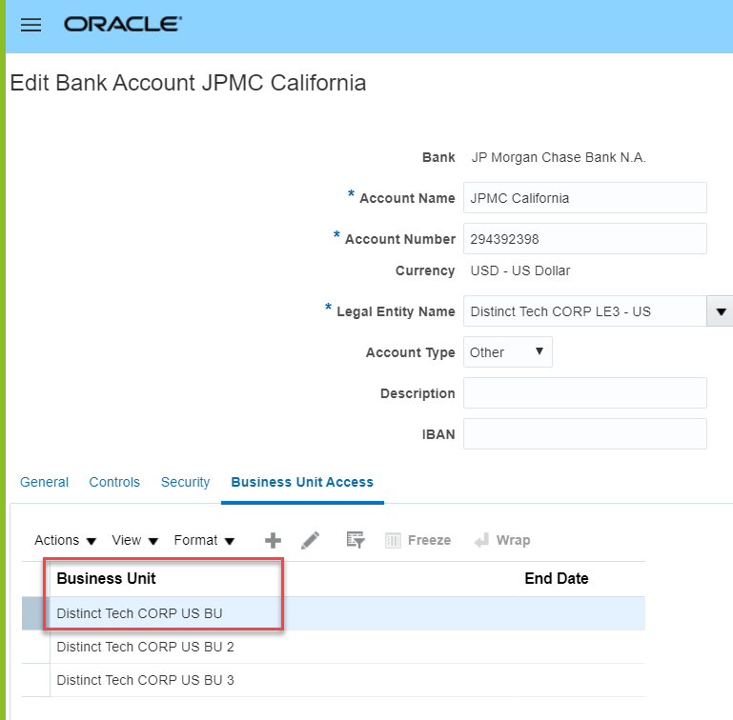
Internal Bank Account
Legal entity owning bank account is tagged on bank account record
Each Bank Account has “Account Use” identified to determine which modules can use this account
We will not be using Cash Clearing i.e. no accounting will be generated as part of bank statement reconciliation process
We will be assigning one BU for LE to support each LE using one account for third party transactions
Typical practice to establish a way to uniquely tie a GL account / account combination to each bank account enabling faster reconciliation of GL with Bank Statement

Slide 24










Internal Bank Account Model
The Bank Account model enables you to define and keep track of all bank accounts in one place and explicitly grant account access to one / multiple BUs. Below is a sample of how we will model for client
client
Bank Accounts to Business Unit Association
Bank and
Branches
Bank Accounts
BU for client
BU for LE2
BU for LE3
Supported by Oracle, but not applicable for client requirements
Receivables
Payables
Payroll
client design is each LE owns its bank accounts. Payroll (HR process) is not in Oracle

Slide 25
Bank Validations
When creating a new Bank / Branch / Account Oracle checks for unique banks, branches, accounts, and makes bank account number mandatory
Additionally, Oracle has pre-built country specific validations for below fields:
Bank Code
Branch Number
Account Number
Check Digit
IBAN
Using setup these country specific validations can be disabled (Related profile option: Disable Country Specific Bank Validations)
20B Documentation link to country specific validations: https://docs.oracle.com/en/cloud/saas/financials/20b/faofc/manage-cash-management-and-banking.html#FAOFC1478593
Highly recommended to not disable (i.e. keep enabled) country specific bank validations as they are built by Oracle based on requirements in each of those countries. Data quality issues on Bank / Branch / Account should be addressed when loading instead of disabling validations

Slide 26
4.1 Conversion – Internal Bank Accounts & Associated Banks / Branches

Slide 27
Conversion
The below table captures conversions for Banks, Branches & Accounts. Plan is to convert all active Internal Bank, Branches & Accounts into Oracle to support ERP processes
Type of data | Data Entities | Scope | volume | data migration strategy
Master Data | Banks | Associated to Internal Bank Accounts | <100 | Use NetSuite to build first list Review list and make updates All future cycles use list as source of data i.e. no data extraction to avoid bank account changes in Netsuite for any data cleansing / enrichment Any new updates or changes to list to be done as part of review for each conversion cycle
Master Data | Bank Branches | Associated to Internal Bank Accounts | <100
Master Data | Internal Bank Accounts | All active Internal Bank Accounts required for ERP processes | 100
During Conversion, Bank and Branches required to support client Bank accounts will be provided by RTR team and approved by Treasury.
Additional Banks and Branches to support Supplier conversion, to be covered in Supplier conversion process – but file will need approval from Treasury

Slide 28
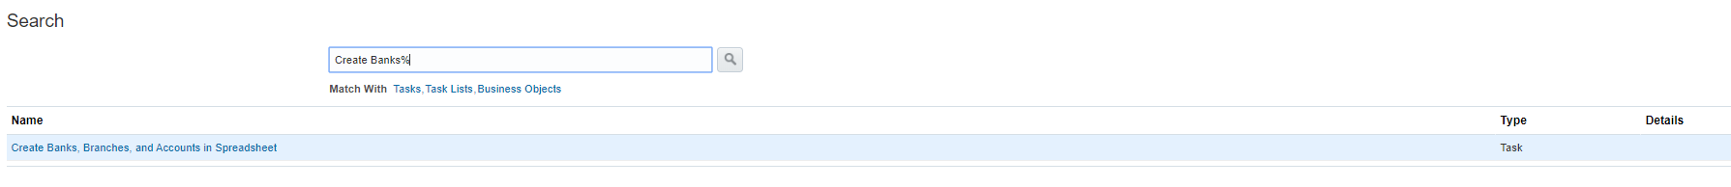
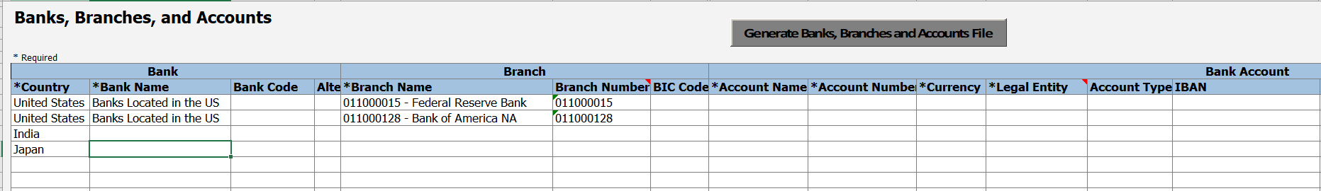
Creating Banks, Branches and Internal Accounts using Spreadsheet
Oracle provides an Excel Spreadsheet (Rapid Implementation) that contains the most basic information to creating bank, branch, and account all together. If additional fields are required than in this spreadsheet, it will need update from front end after upload. Typically this involves providing BU access
A csv file can be generated once the user has filled out the required information on the spreadsheet
The user can manually upload the generated csv file to the server from Oracle Scheduler. Then the upload process will create bank, branch, and account based on the information on the spreadsheet
Template will be shared to collect bank / branch / account information for client Bank Accounts

Slide 29
4.2 Maintenance – Banks & Branches

Slide 30
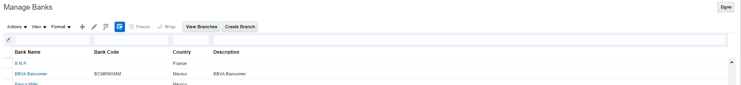
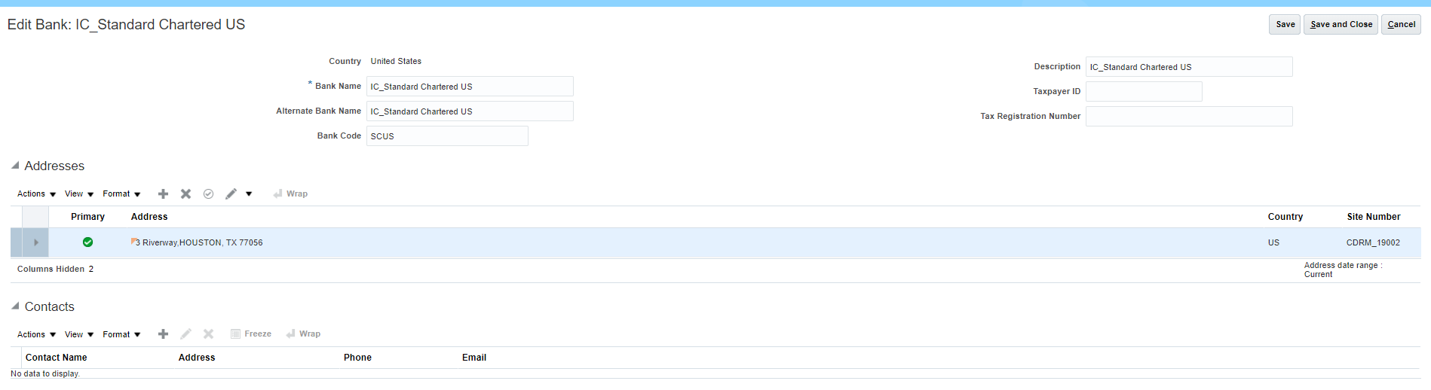
Maintain Bank Account - Banks
Creating a bank is the first step in the bank account creation. You can:
Search for existing banks to view and update
Create a new bank
Establish ownership for Bank and Branch maintenance post go-live

Slide 31
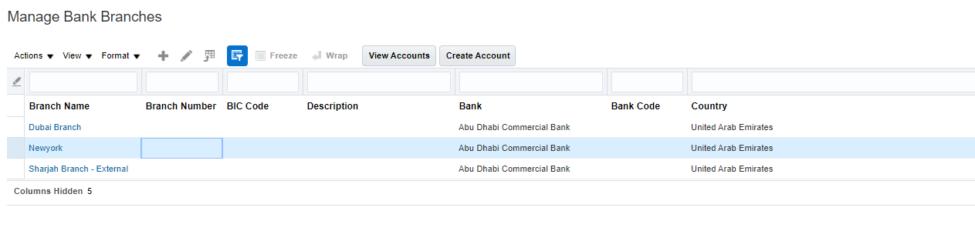
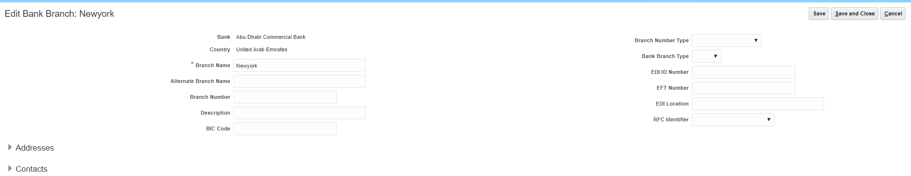
Maintain Bank Account – Bank Branches
Once the bank is created, the next step is to create a branch or branches and associate to the bank

Slide 32
4.2 Maintenance – Internal Bank Accounts

Slide 33
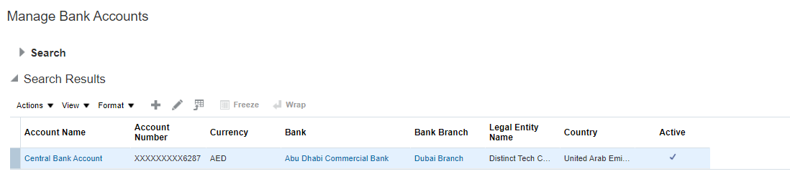
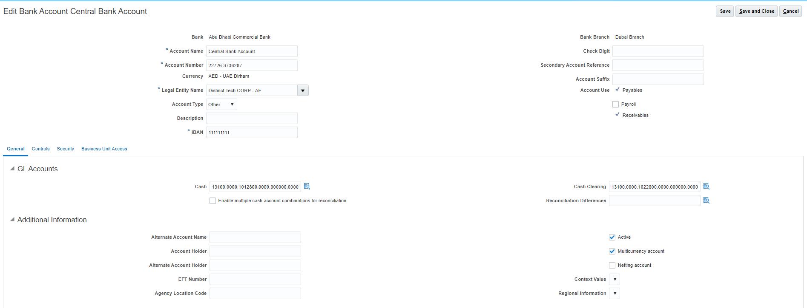
Maintain Bank Account – Bank Accounts
Internal Bank Accounts

Slide 34
5. Reconcile Bank Statements

Slide 35
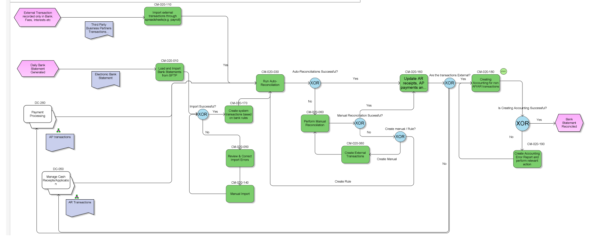
L2 – Process Flow – Bank Statement Reconciliation

Slide 36
L2 – Reconcile Bank Statements
Process Map Alignment
L2 Overview
L0: Record to Report
L1: Manage Cash
Bank information
Bank Reconciliation
Roles
Bank
Bank Branches
Bank Accounts
Loading Bank Statement
Matching Rules
Parsing Rules
Transaction Codes
Cash Manager Analyst
Cash Management Supervisor
Related KPIs
Bank Reconciliation Frequency
Effort per bank account reconciliation
Key Inputs
Leading Practices
Process Inputs (Upstream/Downstream)
Bank Statement Reconciliation:
Identify bank accounts for systematic reconciliation basis parameters like high volume of transactions etc. Use rules based reconciliation. Use Manual reconciliation for any pending lines / fallouts Work with bank to use industry standard bank formats for automated bank statement imports
Bank Statements
Master Data
Reconciliation Rules (Matching Rules, Parsing rules etc.)
Key Design Decisions
NA

Slide 37
5.1 Bank Statement Processing

Slide 38
Reconciliation Process Overview
The process of Reconciliation contains the below listed steps
Configuration
Create
Create Bank, Branches and Accounts.
Transaction
Import
Get the bank statements from Bank and upload it to the system.
Verify
Verify the bank statement received. Raise concerns, if any.
Reconcile
Reconcile the bank statement.

Slide 39
Load Bank Statement
Load and import bank statements in Oracle Cloud Cash Management by any of the following methods:
Standard Formats
Automatic Bank Statement File Import
Manual Bank Statement File Import through Oracle Web Center
Non Standard Formats (not recommended)
Front End
Spreadsheet (FBDI)
Load and import electronic bank statements (Formats supported listed below):
BAI2
SWIFT MT940
EDIFACT FINSTA
ISO20022 CAMT052 V1 - camt.052.001.01
ISO20022 CAMT053 V1 - camt.053.001.01
ISO20022 CAMT053 V2 - camt.053.001.02
ISO20022 CAMT053 V3 - camt.053.001.03
Recommend to work with bank and use industry standard formats for bank statement. Most major banks support industry standard formats

Slide 40
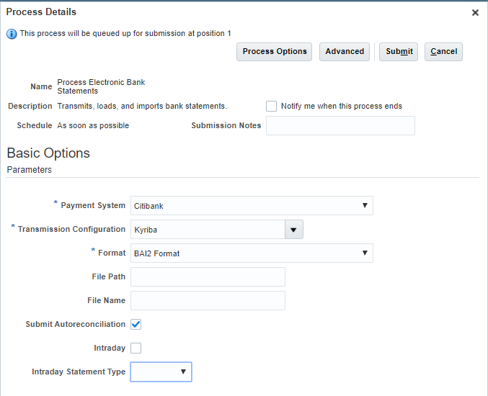
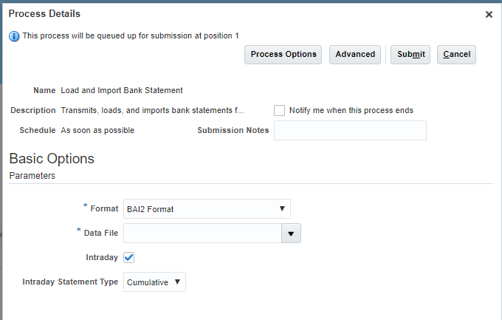
Load Bank Statement for standard formats – Import Options
Use the payment transmission configuration feature to automate the bank statement file import process. The process uses the payments transmission feature to connect to bank and download the bank statement file for subsequent processing and loading into the application.
Use the document repository of Oracle Web Center Content Management to load and import bank statement files. The account, fin/cashManagement/import, is created on the Web Center for the users of Oracle Cloud Cash Management.
.
Which option to select will be driven basis technical options supported by IT including security etc.

Slide 41
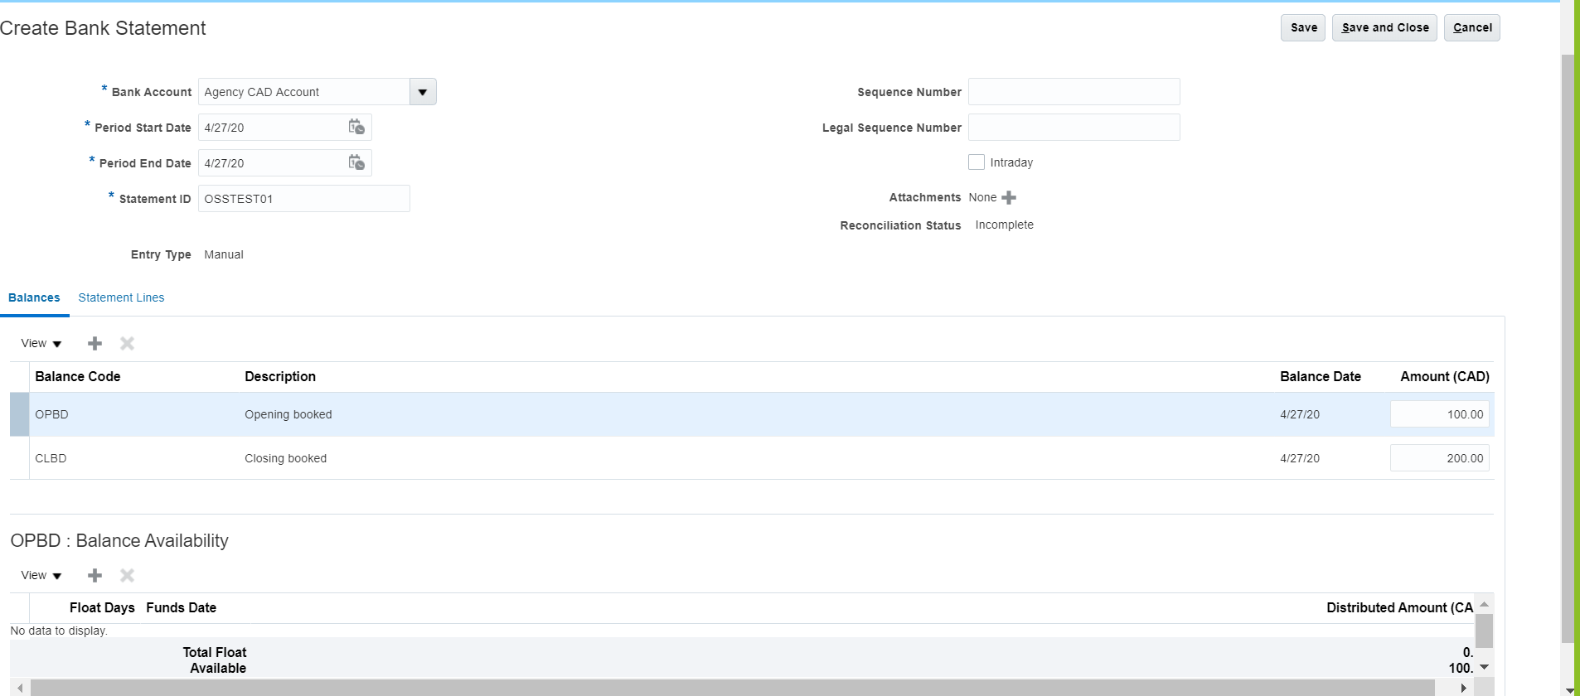
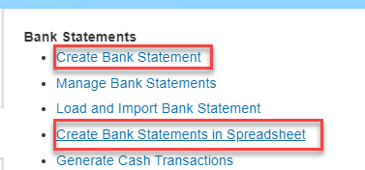
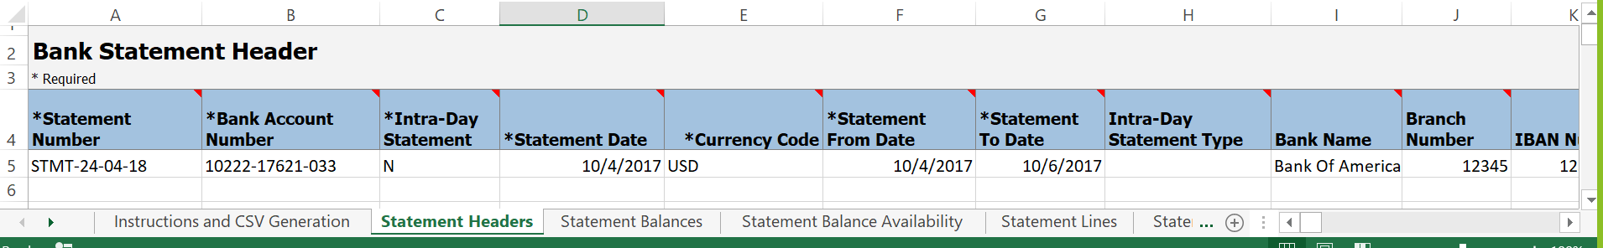
Load Bank Statement for non-standard formats – Import Options
Typically bank statements are interfaced for identified bank accounts using standard formats

Slide 42
5.2 Bank Statement Reconciliation

Slide 43
Reconcile Bank Statements
Once you have entered detailed bank statement information into Cash Management, you can reconcile that information with your system transactions. Cash Management provides two methods of reconciliation:
Automatic
Manual
Automatic
Bank statement details are automatically matched and reconciled with system transactions. This method is ideally suited for bank accounts that have a high volume of transactions.
Manual
This method requires you to manually match bank statement details with system transactions. The method is ideally suited to reconciling bank accounts that have a small volume of monthly transactions. You can also use the manual reconciliation method to reconcile any bank statement details that could not be reconciled automatically.
In current state, bank statement reconciliation is manual. Intending to automate all bank accounts will be jump. Steps involved are:
Identify Bank Accounts
Establish Bank relationship to import files in one of the Oracle supported format
Work with RTR/Treasury team to build rules for automated reconciliation. Typical challenge is observed in testing to create data to test support testing
Recommend: Identify priority bank accounts that will have high impact (e.g. high volume) and attempt to automate bank statement load and associated reconciliation rules
Currently no RICE component is identified for Bank Statement automated import. Based on decision would recommend adding RICE item to track integrations conversations with bank, testing etc.

Slide 44
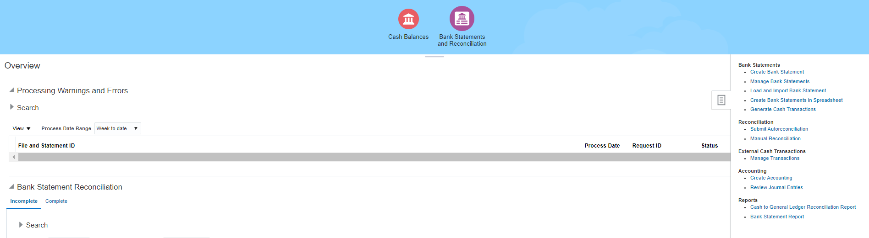
Bank Statement & Reconciliation Dashboard
This dashboard provides you access to perform various transactions on the bank statement and reconciliation.
Cloud Oracle (key out of box setups available For REconciliation)
Tolerance Rules: Define date and amount tolerance rules to be used for manual and automatic reconciliation
Flexible Matching Rules: Allows you to select the criteria for matching and not rely on predefined criteria
Configurable Rule Sets: Increases automatic reconciliation hit rate and minimizes manual reconciliation
Cloud provides seeded bank statement processing formats like for ISO20022 (new), BAI2, SWIFT, and FINSTA
Parse rule sets provides ability to parse information on the statement into named attributes which can be used for reconciliation

Slide 45
5.2.1 Bank Statement Reconciliation (Automatic)

Slide 46
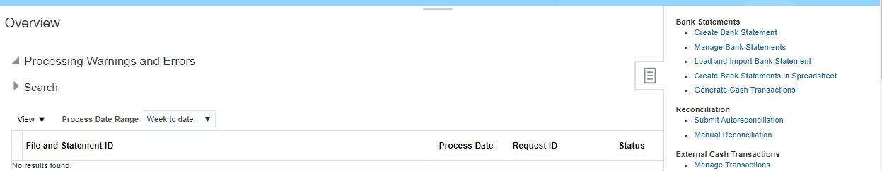
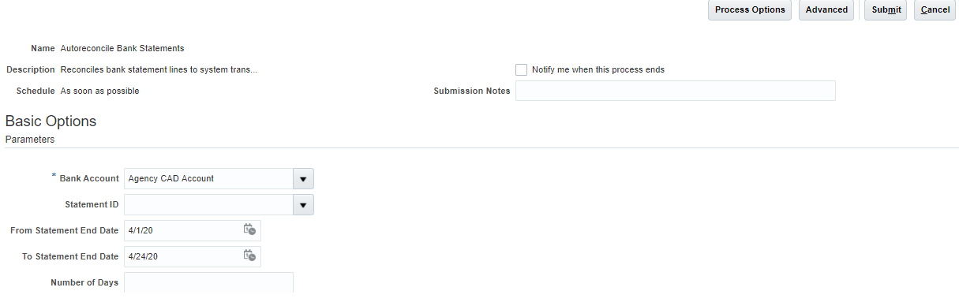
Bank Statement Reconciliation – Automatic Approach
Key Components | Description
Parse Rule Sets | Use to parse inbound addenda and other fields into more granular constituent fields.
Transaction Codes | Expand or modify existing delivered transaction codes or create transaction codes as required. Transaction codes must match your bank's transaction code. E.g. 475 - Check paid
Reconciliation Matching Rules | Use Reconciliation matching rules to determine how to match bank statement lines to system transactions.
Automatic Reconciliation Matching Rule Set | Consists of one or more matching rules and tolerance rules. They must be prioritized or sequenced in the order in which they must be executed
Reconciliation Tolerance Rules | Use tolerance rules to specify date, amount and percentage tolerances that prevent or warn when reconciliation is a breach of a defined tolerance.
Automatic Reconciliation is typically scheduled as per frequency of bank statement import

Slide 47
Flexible framework for Bank Statement Reconciliations
Bank Account
Transaction Creation Rules
Tolerance Rule
Automatic Reconciliation Rule Set
Parsing Rule Set
Priority
Rule
Trnx Code
Search Field
Matching Rules
Parsing Rules
Priority
Rule
Trnx Code
Search Field
Priority
Matching Type
Matching Criteria
Transaction Code
Rule
Priority
Rule
Trnx Code
Search Field
Priority
Matching Type
Matching Criteria
Transaction Code
Rule
Priority
Matching Type
Matching Criteria
Transaction Code
Rule
One to One type of matching rules are typically kept as higher priority than many to one or one to many rules.
Sample Typical rules: One to One for AP Payment based on Reconciliation Reference (E.g. Invoice#) and Amount; One to One for AR Receipt based on Amount for manual receipts; One to Many grouped by Receipt batch number matched on date & amount
Will need to work with PTP and OTC Payments and Receipts processes to see if any specific reference based rules can be built

Slide 48
5.2.2 Bank Statement Reconciliation (Manual)

Slide 49
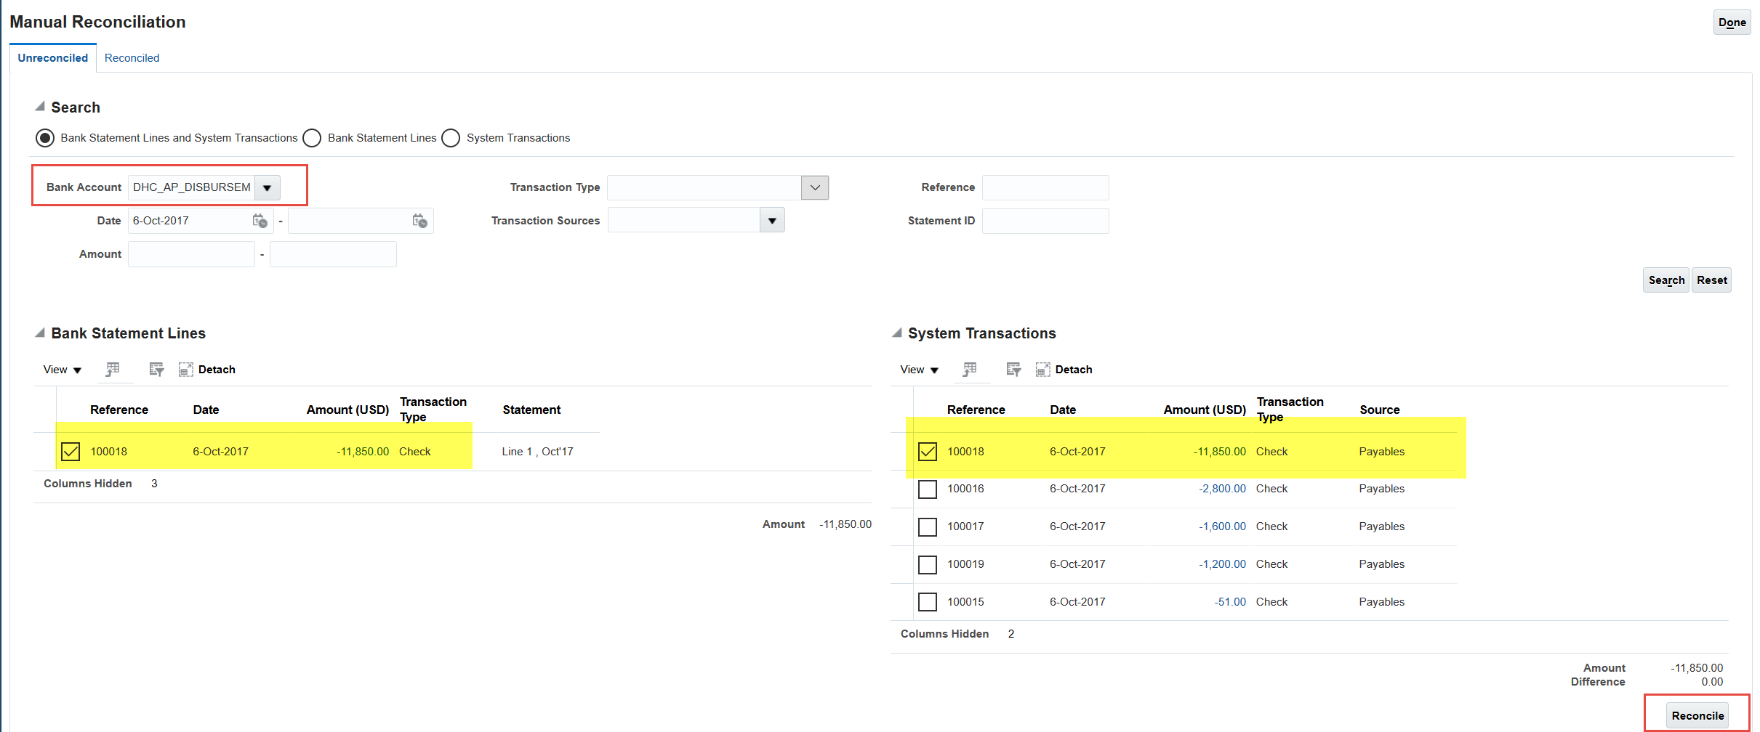
Bank Statement Reconciliation – Manual Approach

Slide 50
5.2.3 Bank Statement to GL Reconciliation

Slide 51
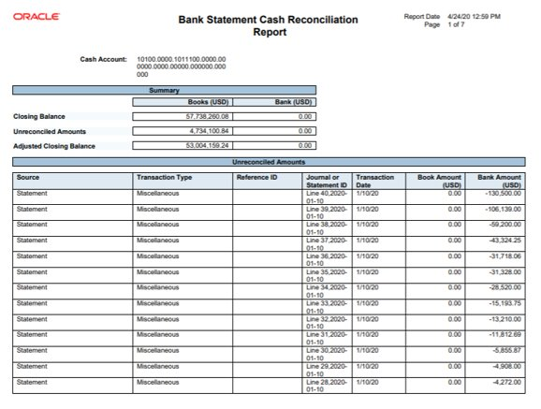
Reconciliation Bank Statements Standard Reports
Cash to General Ledger Reconciliation Report – This is available as a predefined report in Oracle, Cash to General Ledger Reconciliation Report compares the GL Cash Account Balance against the Bank Account Balance. This Report also lists the subledger transactions that are accounted in GL but they are not reconciled in Cash Management. Additionally it displays the unreconciled GL cash account journal entries and unreconciled bank statement lines that help identify the discrepancies between the balances. This is done based on the specified period.
Establish a way to uniquely tie a GL account / account combination to each bank account enabling faster reconciliation of GL with Bank Statement

Slide 52
6. Bank Account Transfers and External transactions
Notes:
Inter bank account – task in CM
1) Generate a payment file and send bank
2) don't generate payment file
External Transactions:
Based on bank statement, like extra bank charges and we will create in Oracle those entries, for it to reconcile. based on transaction codes

Slide 53
6.1 Inter Bank Account Transfer

Slide 54
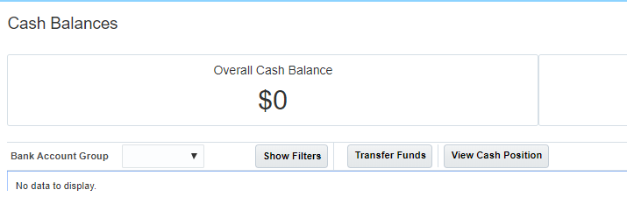
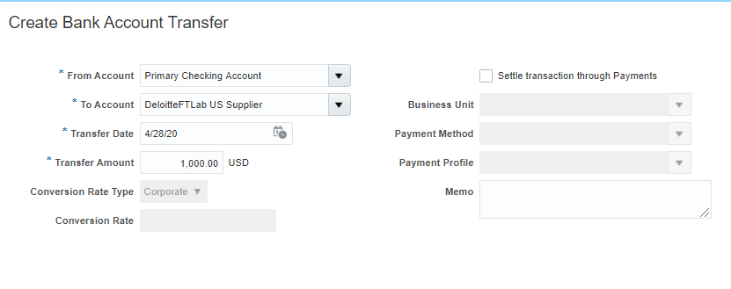
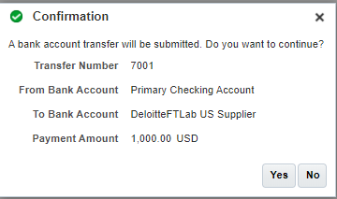
Internal Bank Account Transfer
You can use Bank Account Transfer feature to create system transactions which can then be reconciled with bank statement lines

Slide 55
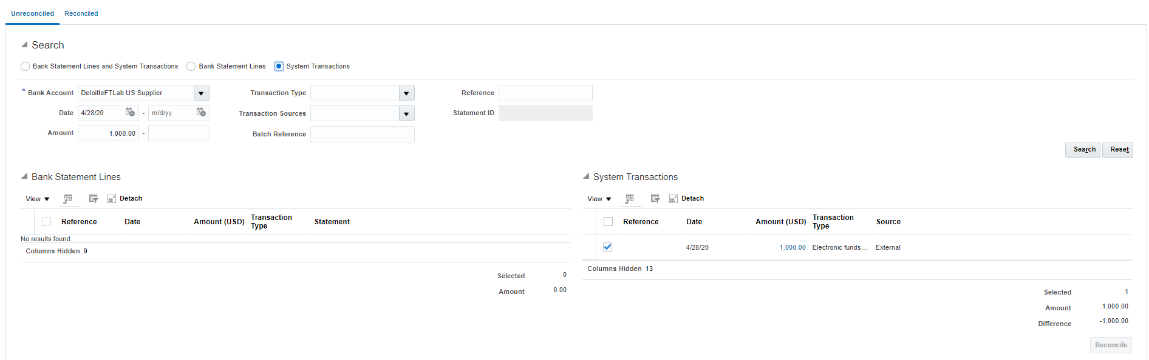
Internal Bank Account Transfer
After the transfer, the transaction is available for reconciliation

Slide 56
6.1 External Transactions

Slide 57
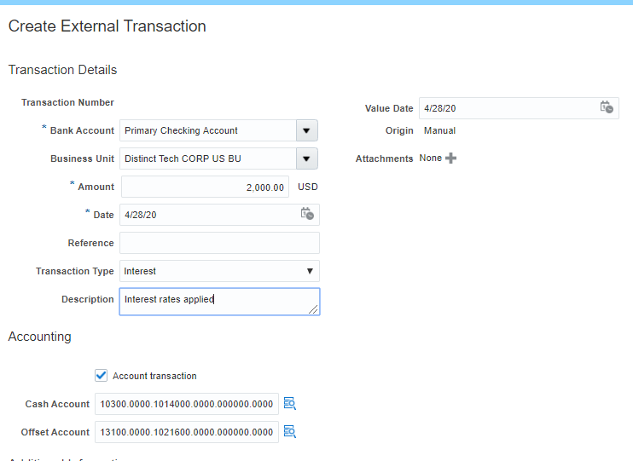
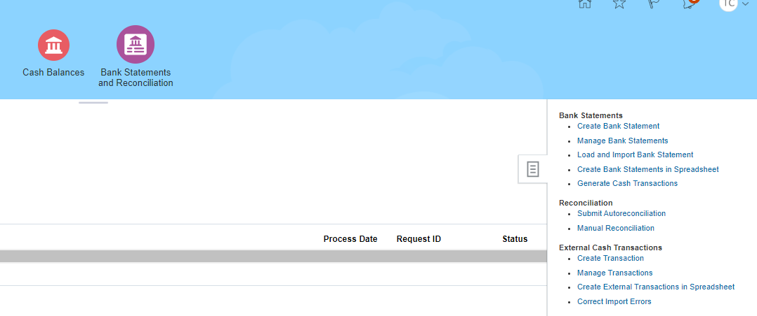
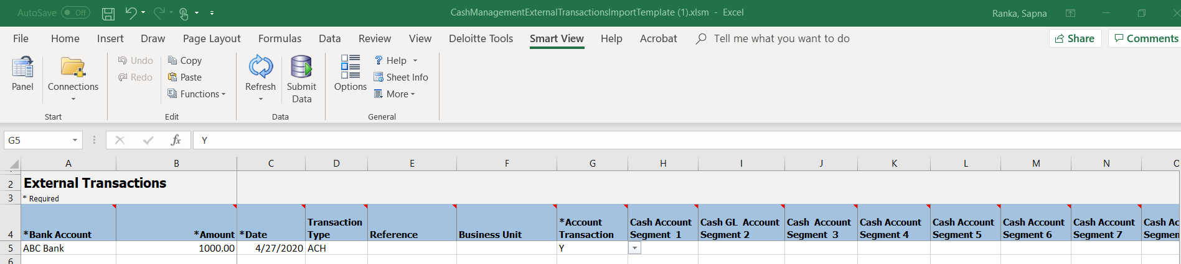
External Transactions - Manual
Use External transaction to record transactions that appear in bank statement like Interest, Service Charge etc.
External transactions can be created from browser or using spreadsheet
From Browser
Spreadsheet

Slide 58
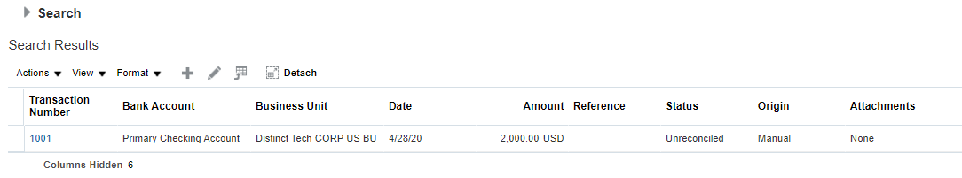
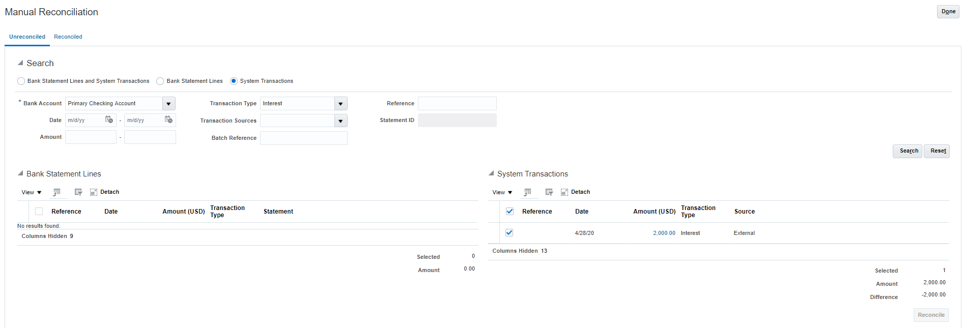
External Transactions – Manual
Review the transaction, it is now available for reconciliation against bank statement

Slide 59
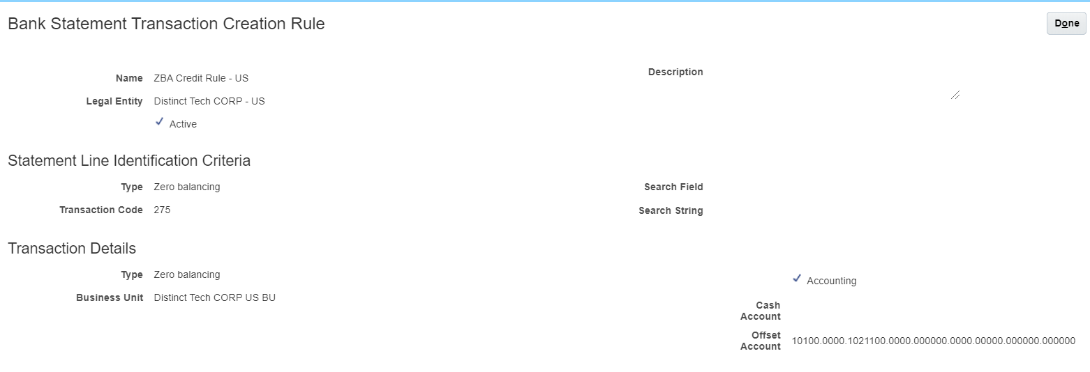
External Transactions – Automated
You can define an external transaction creation rule basis Transaction code and/or string patterns on bank statement descriptions. These would create transactions that can be reconciled against bank statement.
Typical use case: ZBA / Daily bank balance sweep

Slide 60
7. Cash Forecasting
Notes:
It is smartview report to forecast for next 5 days.

Slide 61
Cash Forecasting
The Oracle Cash Management Cash Positioning and Forecasting provide solutions to accurately report cash balances and position.
You have the flexibility to create cash position and forecast (short term) reports by using Smart View and financial reports to meet reporting requirements
We have visibility to a variety of sources available, such as invoices, receipts, and payment. Scheduled processes are designed to streamline the extraction and import of cash flow data from multiple applications such as:
Oracle Accounts Payable (AP)
Oracle Accounts Receivables (AR)
Oracle Cash Management External Cash Transactions
Cash Management Bank Statements

Slide 62
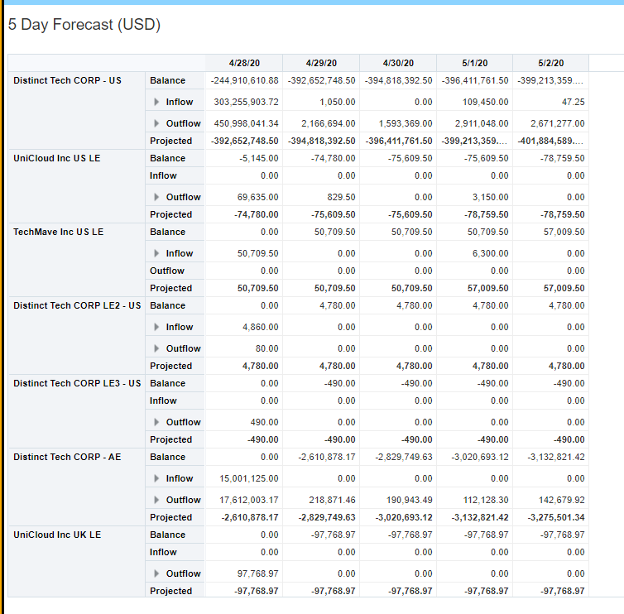
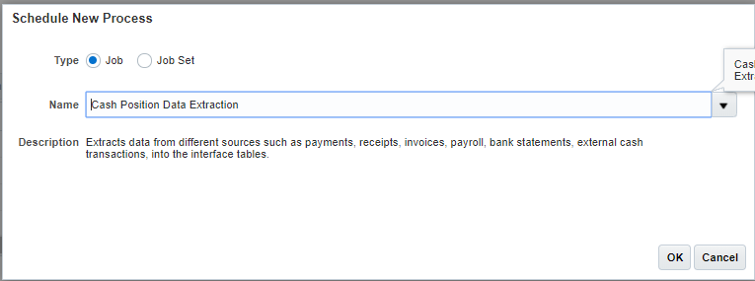
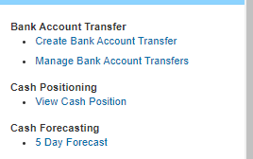
Cash Forecasting – For 5 Days (Front end)
Preparing a Cash forecast by running extraction and running the forecast report from front end which will give a forecast of 5 days by legal entity

Slide 63
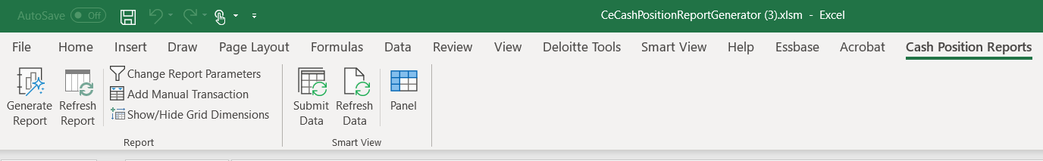
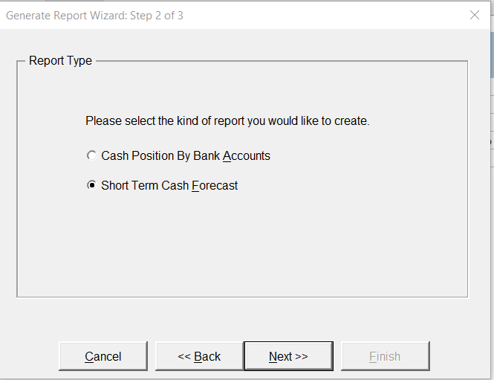
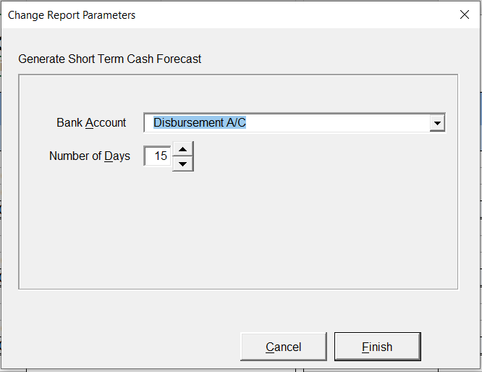
Cash Forecasting – Using SmartView
Prepare the cash forecast report, run the Create Cash Position Report and select the type of report and bank account along with the number of days to be forecasted and then run the report. This forecasting is by Bank Account

Slide 64
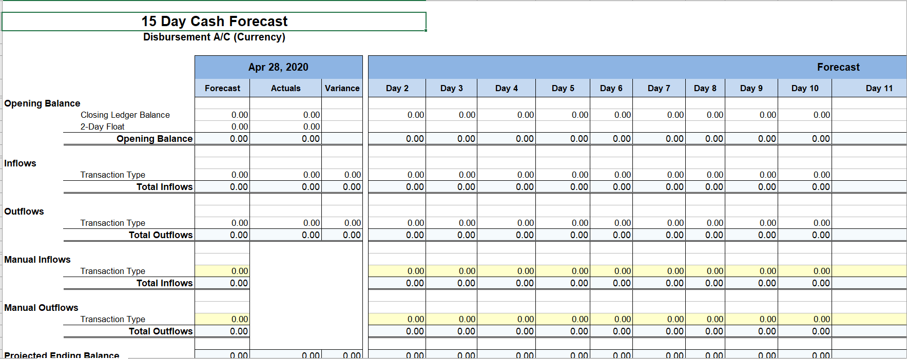
Cash Forecasting – Using SmartView
SmartView based forecasting is by Bank Account. It only includes those transactions that have specific bank account tagged

Slide 65
8. User Stories

Slide 66
What is a user story?
As a Fixed Assets Analyst
I want to be able to create assets from AP invoices automatically which are tagged to an asset account
So that asset procurement process is integrated and has an audit trail with Supplier and Invoice information
User Story
Written from the point-of-view of an end user, they encourage us to embrace a user-centered approach
A basic unit of work that captures a specific piece of functionality representing some business value that can be delivered within a sprint
Includes enough detail to enable the project team to make planning decisions
If the user story statement contains the word "and" or "or", it might be too big and should be broken down into smaller and multiple stories
Avoiding vague personas like “As a user” or “As any user”
User Story statement
As a…
The system user or the persona who will be using this story
Let’s us step into the shoes of the beneficiary
I want to…
Achieve a goal as a result of using the system
Tells us the right thing to build.
So that…
Tangible benefits that will be realized after using the system
Guides us on building the thing right

Slide 67
Acceptance Criteria
Must tie to and is specific to a user story
Overview
Explains the conditions of satisfaction Provides a set of conditions that the story must meet to be accepted as complete Helps answer what is needed in order for the story to provide value Helps implementation team know what functionality to deliver Helps testers know when testing the user story is complete
Example
User Story | Acceptance Criteria
As a Fixed Assets Analyst , I want to be able to create assets from AP invoices automatically which are tagged to an asset account So that asset procurement process is integrated and has an audit trail with Supplier and Invoice information | Given a new AP invoice is entered and coded to an asset GL account When I request new assets to be added to my asset book Then Oracle automatically feeds them to my asset book for me to review and add
 | Given I have added a new asset into service When I lookup the asset Then I will be able to view the supplier invoice details for the asset purchase
Notes:
Module 2: Discovery Project Planning and Sprint 0

Slide 68
User Stories
User stories can be reviewed on google drive. Below is link to Gsheet to review user stories:
https://docs.google.com/spreadsheets/d/1NoLsHUSDRGEC4pkQlcX0fVkSBeWjurF3Sks0m2bdomY/edit?usp=sharing
User stories for this session can be filtered using L2 process(es) discussed in the session. Filter criteria for this session:
L1 (Column B) | L2 (Column C)
Manage Cash | Reconcile Bank Statements
Manage Cash | Maintain Bank Account
Manage Cash | Cash Forecasting
How to provide feedback on updates: Send an email with additions / updates to
xxx; yyy;zzz
Please include associated session reference. If you can mention associated L1/L2 will be great

Slide 69
9. Next Steps

Slide 70
Next Steps
Next Steps | Due Date | Owner
Document critical variations / exception scenarios not captured in today’s session | 5/7 | Client Team
Update process flows based on feedback | 5/15 | XXX
Review and approve user stories | As per plan | XXX
Provide acceptance criteria for each user story | As per plan | XXX
Document change impacts | 5/7 | XXX
Prepare first draft of Configuration workbooks | 5/22 | XXX

Slide 71
Sprint 4 - RTR Workshops
Track | Workshop Name | High-level Agenda | Planned Date / Time
RTR | RTR - IC - Intercompany Transaction processing | - Perform Intercompany transactions - Within Ledger - Perform Intercompany transactions - Crossing Ledgers [Journals] - Perform Intercompany transactions - Cross Ledgers [Invoices] - Discuss Netting/Settlement options for Invoice based IC - Intercompany approvals - Other IC Setups | 4/27/2020 8 AM to 10 AM PST
RTR | RTR - GL - GL Actual Balance Conversion (USGAAP & Local GAAP) | GL Balance Conversion - USGAAP & Local GAAP (Actuals) | 4/29/2020 10 AM PST - 12:30 PM PST
RTR | RTR - CM - Bank Account Maintenance and Bank Statement Reconciliation | - Bank account setup & maintenance - Bank statement processing & bank Statement Reconciliation - Inter Bank Account transfer​, External transactions - Cash Forecasting | 4/30/2020 8 AM to 10 AM PST
RTR | RTR - GL - Recurring Journals & Allocations | - Recurring Journals - Allocations | 5/4/2020 8 AM to 10 AM PST
RTR | RTR - GL - Month End Accruals | Manage Accruals (other than GRNI accruals) (includes 2-Way PO) | 5/6/2020 10 AM to 12 PM PST
RTR | RTR - FA - Corp Book Conversion | FA Corp Book Conversion | 5/7/2020 8 AM to 10 AM PST

Slide 72
10. Appendix

Slide 73
10.1 Abbreviations

Slide 74
Abbreviations
Abbreviations | Meaning
R2R OR RTR | Record to Report
P2P OR PTP | Procure to Pay
O2C or OTC | Order to Cash
FA | Fixed asset
AP | Accounts Payables
GL | General Ledger
AR | Accounts Receivables
CM | Cash Management
IC | Intercompany
FCCS | Financial Consolidation and Close Cloud Service
EPBCS | Enterprise Planning and Budgeting Cloud Service
Abbreviations | Meaning
KDD | Key Design Decisions
KFF | Key Flexfield
DFF | Descriptive Flexfield
LE | Legal Entity
BU | Business Unit
BSV | Balancing Segment Value
COA | Chart of Accounts
FBDI | File based data import
ADFDI | ADF Desktop Integrator (Spreadsheet data upload with validations)
SLA | Subledger Accounting
TBD | To be decided
PTD | Period to Date
YTD | Year to Date
DPIS | Date Placed In Service
ACRS | Accelerated Cost Recovery System
MCRS | Modified Accelerated Cost Recovery System
Abbreviations | Meaning
LOV | List of Values
CVR | Cross Validation Rules
Key discussion or conclusion topics
Session notes

Slide 75
10.2 Key Bank Statement Reconciliation Setups

Slide 76
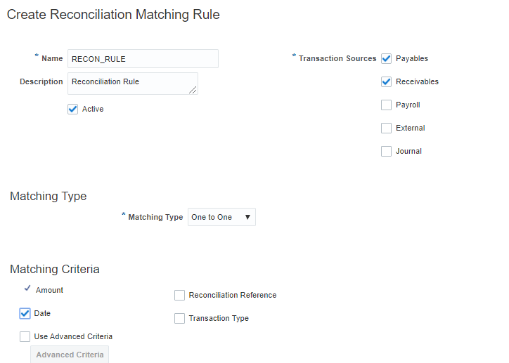
Key Capability Overview – Reconciliation Matching Rules
Matching rules allow you to determine how to match bank statement lines and application transactions.
This helps to achieve a higher match rate in automatic reconciliation and minimizing the need for manual intervention. You define bank statement automatic reconciliation matching rules and assign them to bank statement automatic reconciliation rule sets.

Slide 77
Key Capability Overview – Reconciliation Matching Rules
Define bank statement automatic reconciliation matching rules and assign them to bank statement automatic reconciliation rule sets. After you assign the rule sets to the bank account, the Auto reconciliation process picks up the reconciliation matching rules to achieve a higher match rate.
Specify the following for each matching rule:
Transaction Sources: Payables, Payroll, or External.
Matching Type: One to One, One to Many, Many to One, or Many to Many. The following table explains the different matching types available in Oracle Fusion Cash Management:
Matching Type | Description
One to One | A bank statement line is matched with a system transaction and reconciled against each other
One to Many | A bank statement line is reconciled against many system transactions
Many to One | Many bank statement lines are grouped and reconciled against a system transaction
Many to Many | Many statement lines are grouped and reconciled against many system transactions
Grouping Attributes: Used to group bank statement lines and system transactions based on the matching type you select. The combination of the attributes you select also determine what you can use as the matching criteria. You can use date, transaction type, and reconciliation reference as matching criteria only after you select these as grouping attributes.
Matching Criteria: Includes a list of commonly used matching attributes. You can simply select the attributes to include them in the matching rule you selected. The selected attributes define the matching conditions between the bank statement lines and the system transactions to be matched successfully when they're reconciled. Advanced Matching Criteria enables you to specify additional matching logic or filtering conditions that must be true for the bank statement lines and system transactions to match successfully.

Slide 78
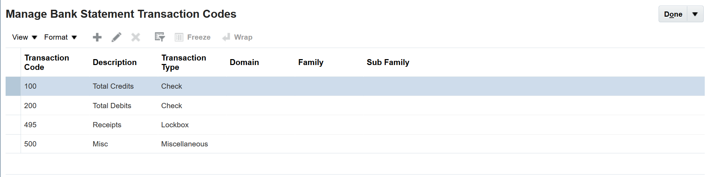
Key Capability Overview – Transaction Codes
Bank statement transaction codes are the internal codes that are used on a bank statement line to identify the type of transaction being reported. These are also referred to as:
Transaction codes
Statement codes
The following codes are examples –
115 - Lockbox Deposit
475 - Check paid
698 - Miscellaneous Fee
Oracle Fusion Cash Management maintains a single set of these codes and transform externally reported transaction codes from other formats into this single normalized set.

Slide 79
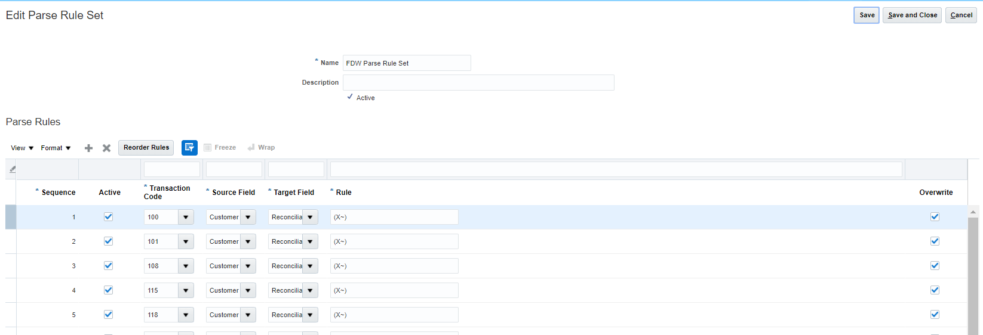
Key Capability Overview – Parse Rule Sets
Bank statement transaction codes are the internal codes that are used on a bank statement line to identify the type of transaction being To transform data during the bank statement import process and to move data from one field to another. The parse rule set is associated to a bank account in the bank account setup; most commonly used to parse data from the statement line addenda field into more specific statement line fields. Each parse rule within a parse rule set consists of the following fields:
Sequence determines the order in which to process the rules.
Transaction Code is the code used to determine the statement line type.
Source is the interface table field that contains the data to be parsed.
Target is the statement line field that the data is to be parsed to.
Rule contains the syntax for determining the data within the source field to be parsed.
Overwrite is used to control whether to overwrite existing data in a target field or skip parsing the data.

Slide 80
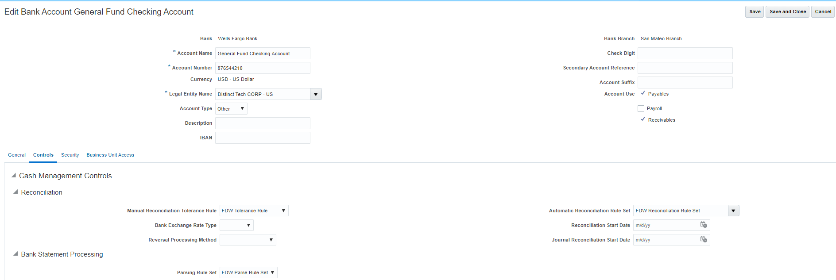
Assigning Rule sets to Bank Account
Manage Bank Account – Assign Automatic Reconciliation Rule Set & Parsing Rule Set to Bank Account
.

